Slide 1
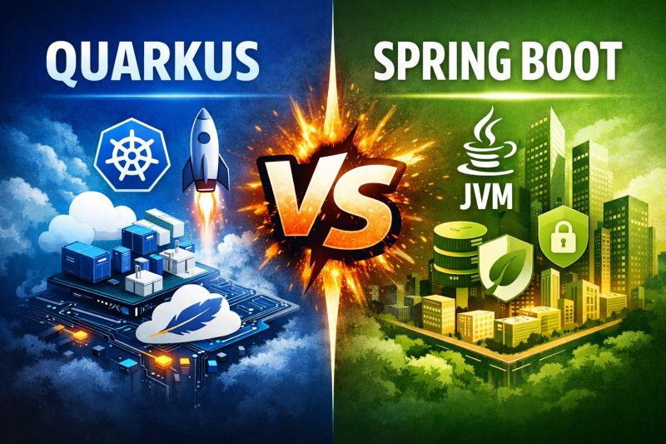
Quarkus vs Spring Boot
Which One Should You Learn in 2026?

Slide 2
🚀 What You’ll Learn
Spring Boot
Quarkus
Key Differences
When to Use What

Slide 3
What is Spring Boot?
🔥 Most Popular Java Framework
🏢 Widely Used in Top Companies
🧩 Auto Configuration Built-in
🌍 Huge Community Support
🚀 Easy to Learn & Get Started
💡 Code less. Build faster. Scale better.

Slide 4
🚀 What is Quarkus?
⚡ Super Fast Startup
⚡ Low Memory Usage
☁️ Built for Cloud & Kubernetes
🧩 Reactive & Non-Blocking by Design
🐳 Perfect for Containers & Serverless
💡 Run Java faster. Scale smarter. Go cloud-native.

Slide 5
Analogy
Spring Boot = 🚛 Truck
Quarkus = 🏍️ Bike

Slide 6
Key Difference
Spring Boot vs Quarkus
Startup → Quarkus ⚡
Memory → Quarkus
Community → Spring Boot 🌍
Learning → Spring Boot
💡 Right tool depends on use case

Slide 7
🚀 When to Use Spring Boot
Enterprise Applications
Banking / Large Systems
Rich Features Needed
Team already knows Spring

Slide 8
⚡ When to Use Quarkus
Use Quarkus when performance and cloud-native efficiency matter.
✅ Best for:
1. Cloud-Native & Kubernetes Apps
Containers
Auto-scaling microservices
👉 Why?
Designed for Kubernetes
Fast startup (milliseconds)
2. Serverless / Functions
AWS Lambda / GCP Functions
👉 Benefit:
Low cold start time
Less memory usage
3. High Performance APIs
Reactive systems
Event-driven architecture
👉 Built with:
Vert.x (non-blocking)
Reactive programming model
4. DevOps-Heavy Environments
CI/CD pipelines
Docker-first workflows
👉 Features:
Live reload
Small container images
⚠️ Not Ideal When:
Your team is new to it
You need heavy Spring ecosystem features

Slide 9
🚫 When NOT to Use Quarkus?
🏢 Traditional Monolithic Applications Spring Boot is often simpler & more mature here
📚 Need Large Ecosystem Support Spring has a much larger ecosystem & integrations
👨‍💻 Team is Already Deep into Spring Switching may reduce productivity initially
🧩 Simple CRUD Applications Quarkus might feel like over-optimization
⏳No performance need Quarkus strengths won’t add much value
🔌 Heavy Dependency on Spring Features Rewriting or adapting may take extra effort
💡 Choose Quarkus for performance & cloud-native needs — not for every project.

Slide 10
Final Takeaway
👉 Beginner → Spring Boot 👉 Cloud / Performance → Quarkus 👉 Best Developers → Learn Both

Slide 11
Thank you….

